Slide 1
Meeting August 13, 2024
The problem with the Abdul surface water depths being too small has been fixed
The repositories for MUT_Source and MUT_Examples have been updated
Stress Period time stepping inputs can now be defined. MUT was previously using fixed default values
A combo box is now used to choose unsaturated function type in GWF materials database
Materials database values are now shown in the MUT echo (.eco) file.
Currently, the MUT build assumes time units of seconds and length units of metres for all inputs.
Some results for the example problems are presented below

Slide 2
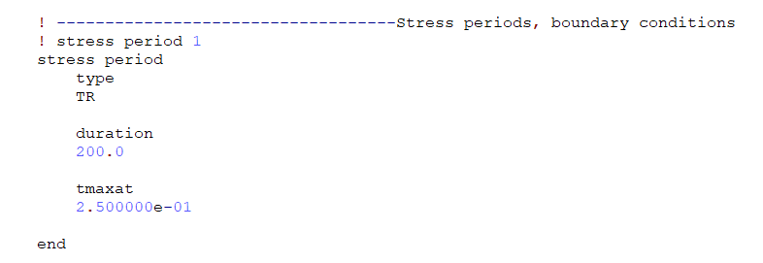
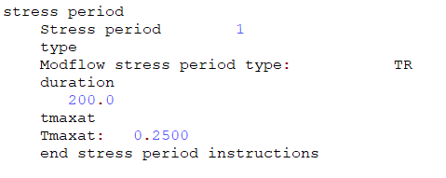
Stress Period time stepping inputs
Default values:
Deltat=1.000000e-03
Tminat=1.000000e-05
Tmaxat=60.0d0
Tadjat=1.100000e+00
Tcutat=2.000000e+00
Default values can be changed inside the stress period definition in the MUT input .mut file as shown here for Tmaxat.
The MUT .eco file shows any defaults that have been reassigned.

Slide 3
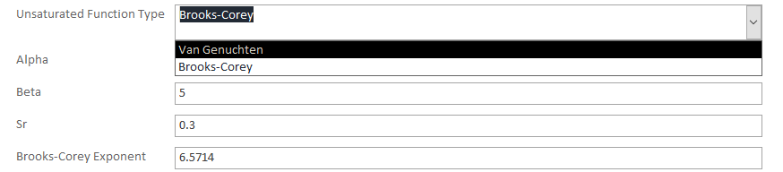
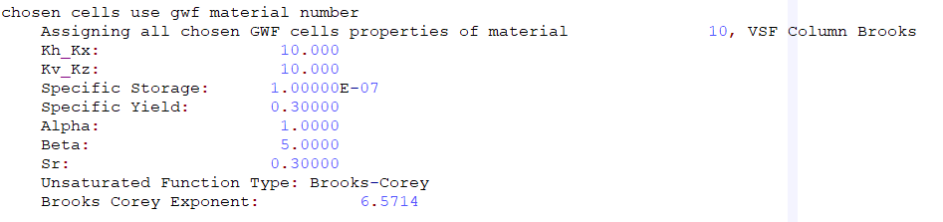
GWF materials: unsaturated function type
Unsaturated function type is now chosen using a combo box in the GWF materials database form. There is an additional input field for the Brooks-Corey Exponent.
If the Unsaturated function type is set to Brooks-Corey, the MUT .eco file also shows the Brooks-Corey exponent value

Slide 4
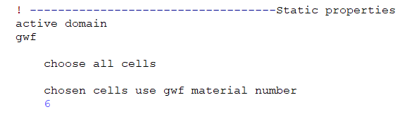
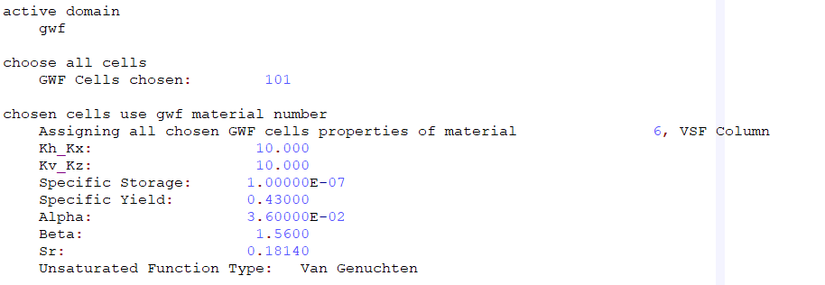
Materials database values
Material property values (e.g. Kh, Kv etc) can be defined in the MUT input .mut file as shown here for the GWF domain.
The MUT .eco file shows the property values that have been assigned

Slide 5
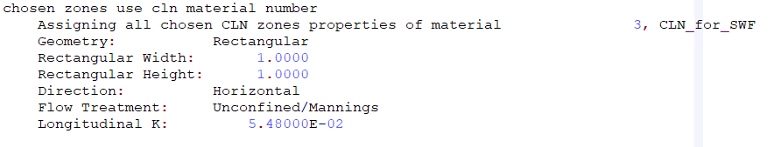
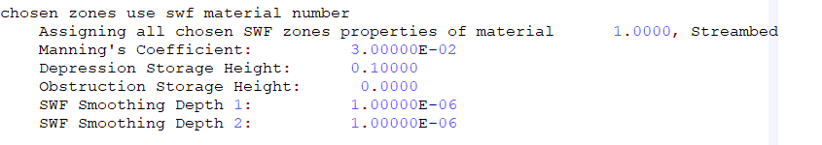
Materials database values for CLN and SWF domains
CLN domain properties assigned are written to the MUT .eco file
SWF domain properties assigned are written to the MUT .eco file

Slide 6
Time and Length Units in MUT
Currently, the MUT build assumes time units of seconds and length units of metres for all inputs.
The 2_VSF_Hillslope and 4_SWF_RCH_CRD examples have been converted to time units of seconds. This fixed the problem we had previously with different results for the two examples.
Although the results match HGS, the 1_VSF_Column example should be checked
The MUT instruction 'modflow output to modflow structure’ does read the time and length unit names (e.g. Seconds, metres) from the listing file but only uses them to to display in Tecplot.
At some point, we will need to implement options for these inputs for the build step.

Slide 7
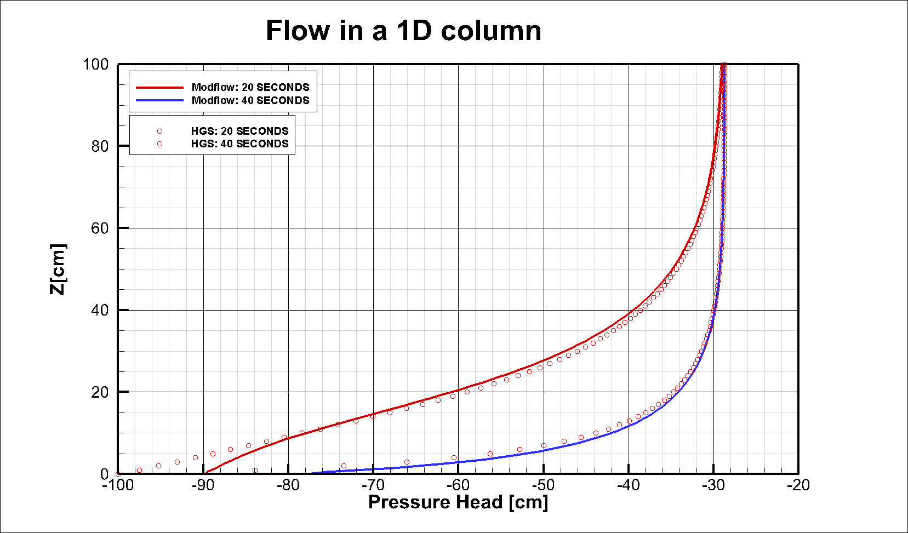

Slide 8
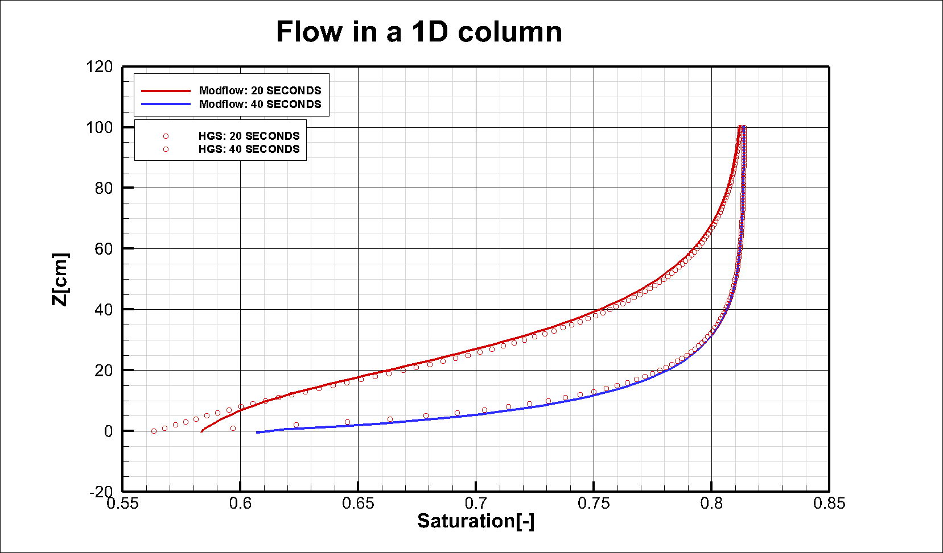

Slide 9
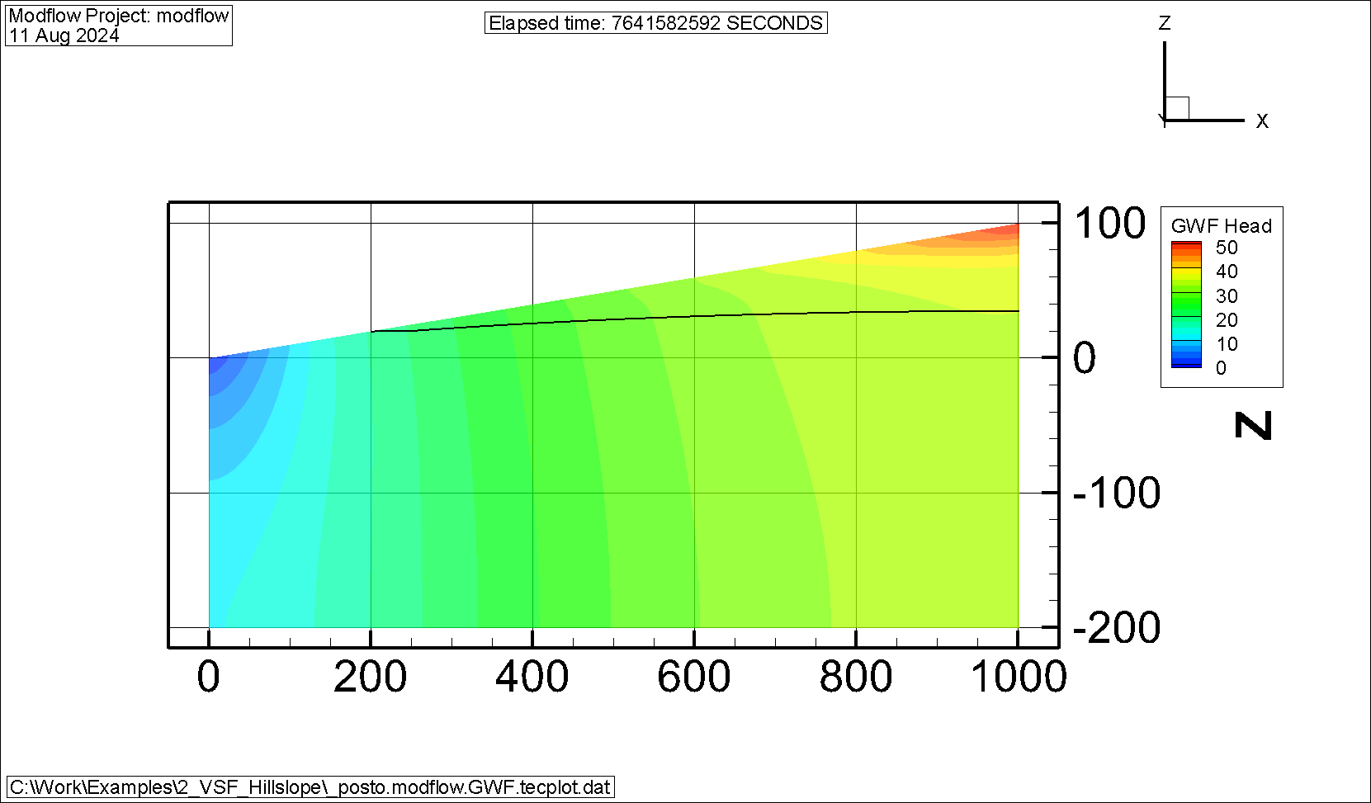
This is the case with recharge and drain boundary conditions across the entire top of the GWF domain and no SWF domain.

Slide 10
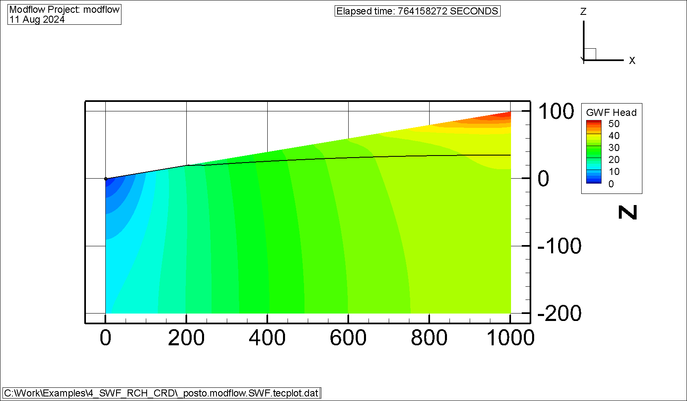
This is the case with a SWF domain and a critical depth boundary at the left end. The water table is extended to show the level in the SFW domain.

Slide 11
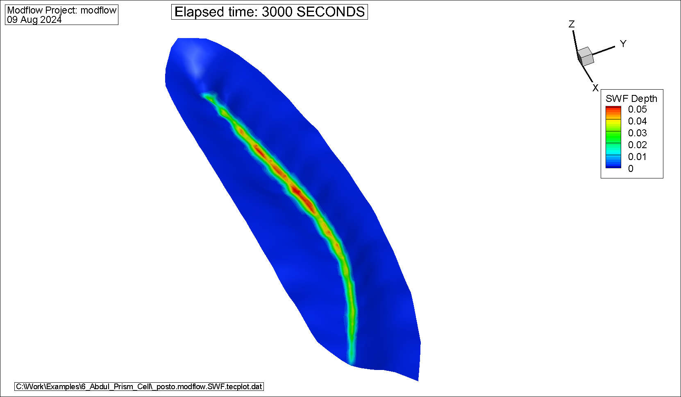
SWF depths are now restored to the results we had before last April.

Slide 12
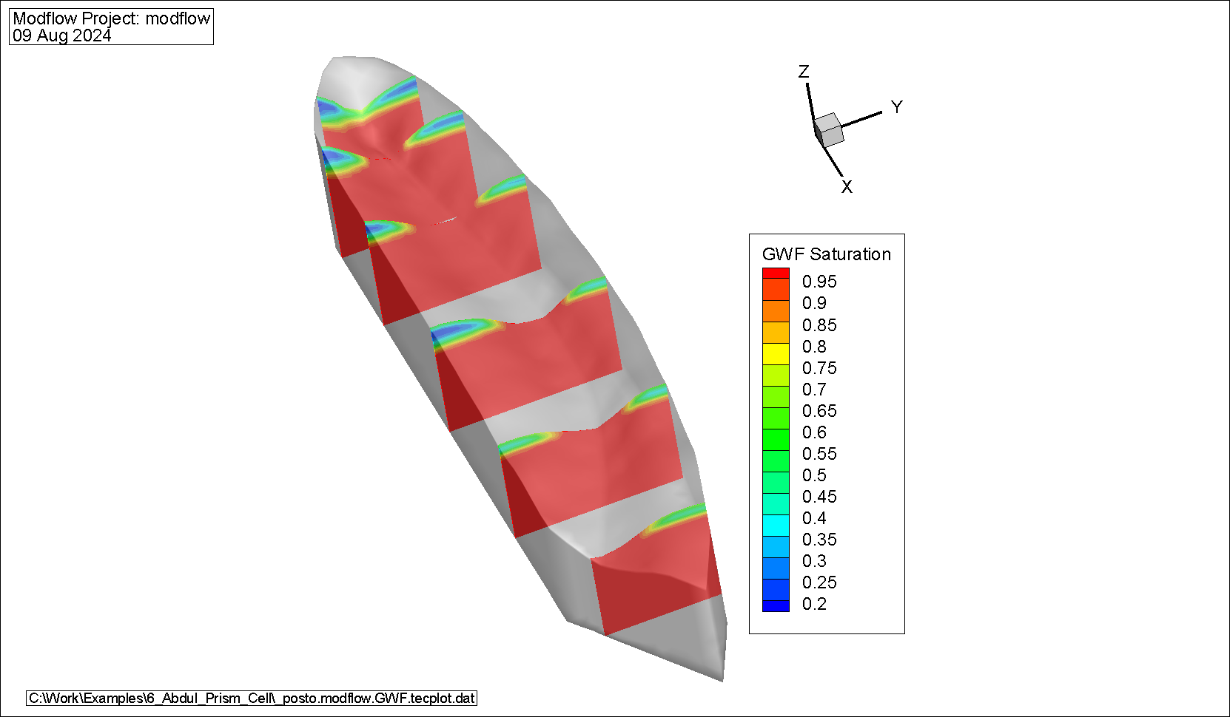

Slide 13
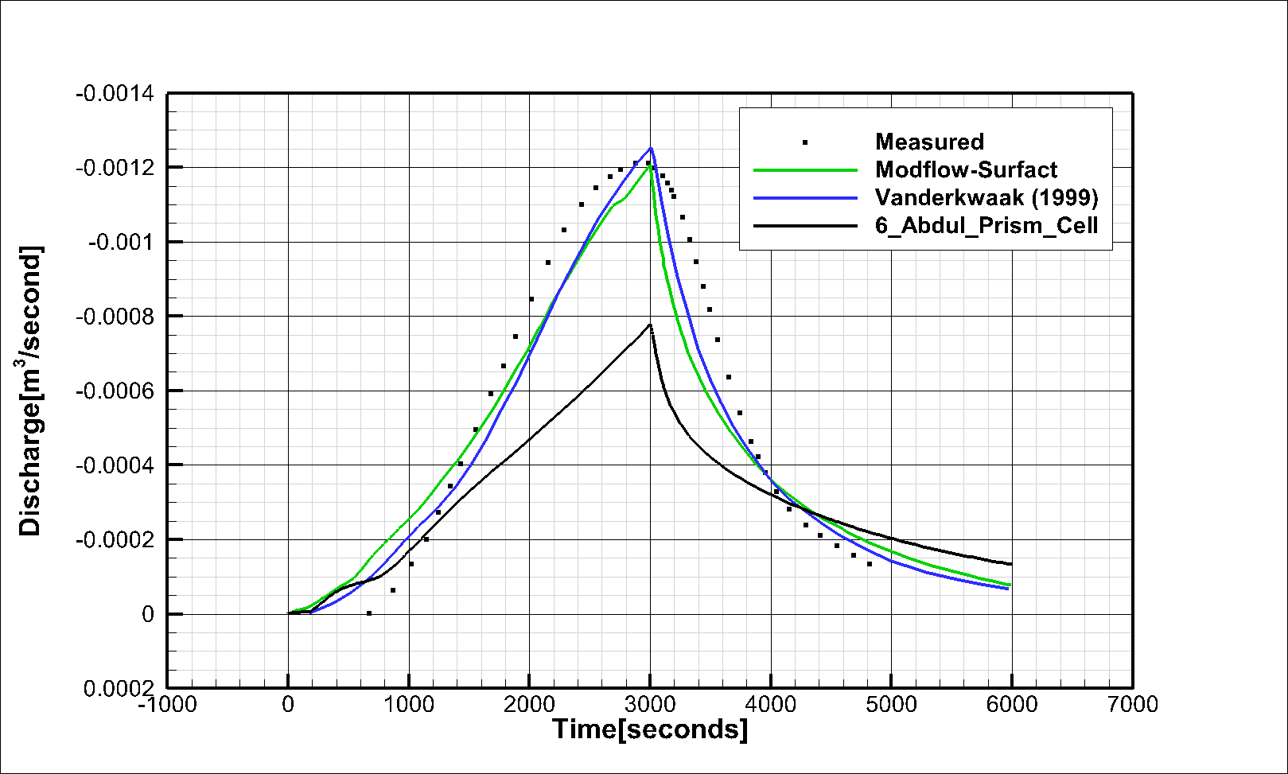
We need to show the results that were calibrated to match HGS and include the HGS results

